Slide 1


DEMAND FORECASTING

Slide 2

CONTENTS
PROBLEM STATEMENT
SCOPE
DATA PREPROCESSING
MODEL FITTING AND EVALUATION
PREDICTION
DATA VISUALIZATION
DATA CLUSTERING

Slide 3
PROBLEM STATEMENT
One of the largest retail chains in the world wants to use their vast data source to build an efficient forecasting model to predict the sales for each SKU (Stock Keeping Unit) in its portfolio at its 76 different stores using historical sales data for the past 3 years on a week-on-week basis. Sales and promotional information are also available for each week - product and store wise.
SCOPE
Build a model that can predict the sales for each SKU in each store for the next weeks, using only the historical sales data and promotional information.
Cluster products based on their sales patterns and visualize these clusters.

Slide 4
DESCRIPTION OF THE DATA SET
VARIABLE | DEFINITION
record_ID | A special code that uniquely identifies each combination of a week, a store, and a product.
week | The starting date of the week for which the data is recorded.
store_id | A unique code for each store; each store has its own identifier.
sku_id | A unique code for each product; each product has its own identifier.
total_price | The price at which the product was sold during that week.
base_price | The initial or standard price of the product.
is_featured_sku | Indicates whether the product was part of a featured promotion for that week.
is_display_sku | Indicates whether the product was prominently displayed within the store.
units_sold | The number of units (products) sold during that week for the specific combination of store, product, and week.

Slide 5
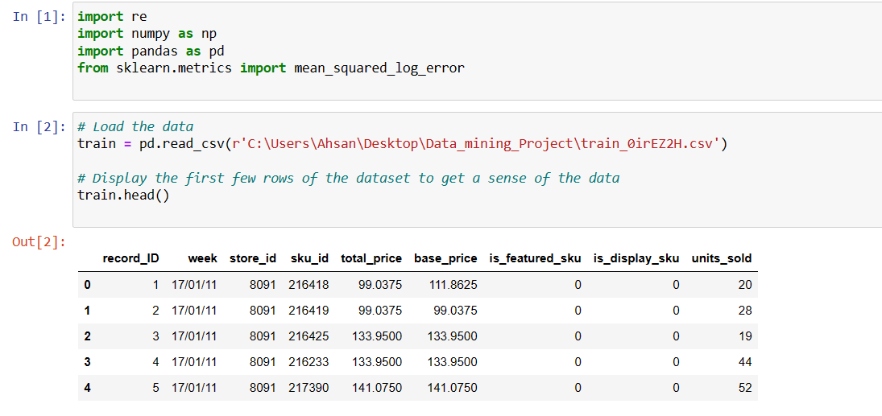
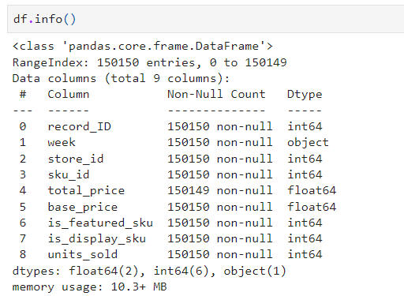
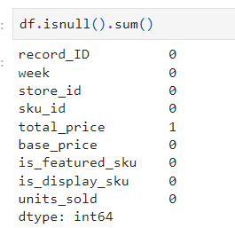
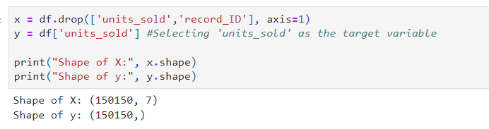
Your text
PREPROCESSING
Load the data and Preview
Filling the mean value with mean value
Previewing the information of Data Frame
Checking the any missing value
Preparing Data: Feature and Target Variable Selection

Slide 6
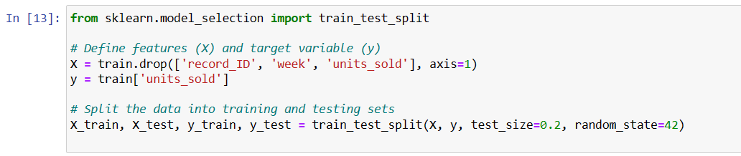
Changing The Week Datatype Object Into Datetime Datatype
Removing Features And Splitting Data For Train And Test The Models

Slide 7
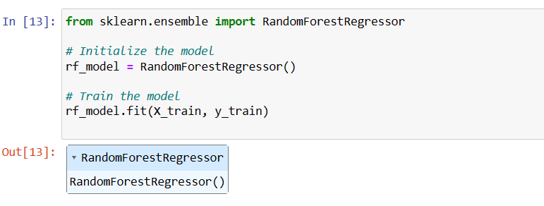
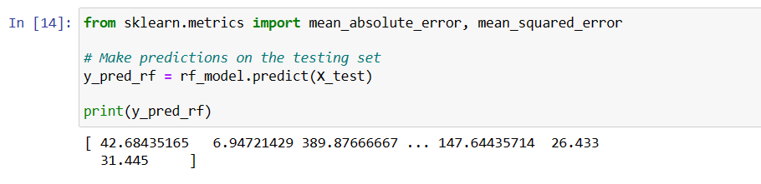
MODEL FITTING AND EVALUATION
Randomforestregressor
Predict the Test value and Looking

Slide 8
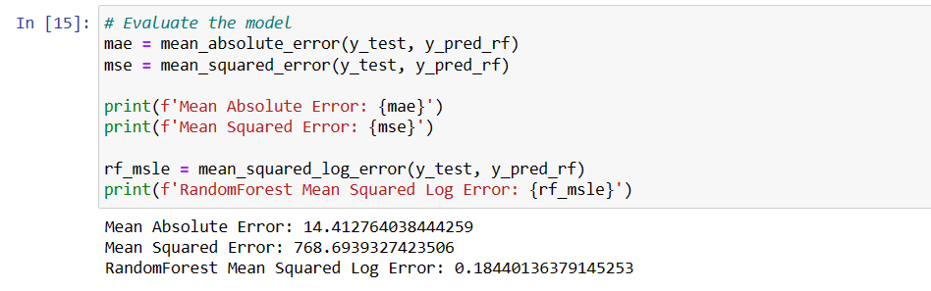
Checking Accuracy by finding Mean Sqaured Error
We found the,
MSE = 768.694
MS log E = 0.1844

Slide 9
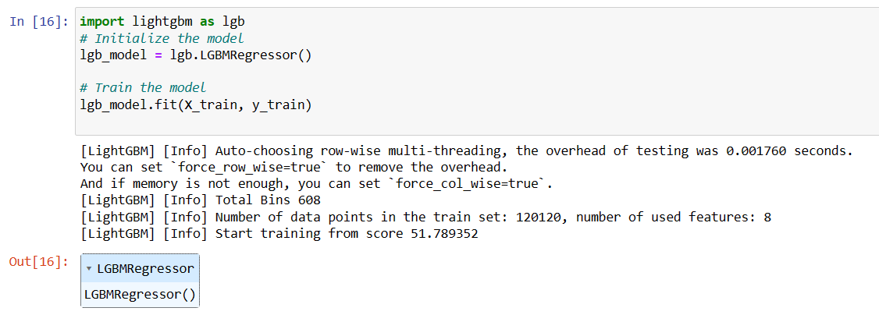
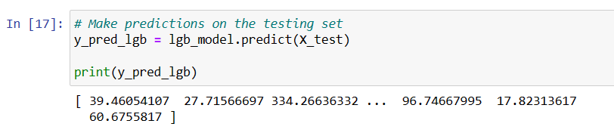
LGBMRegressor
Predict the Test value and Looking

Slide 10
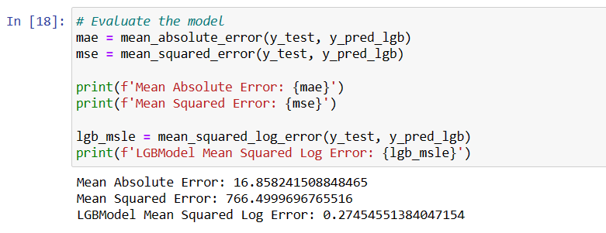
Checking Accuracy by finding Mean Sqaured Error
We found the,
MSE = 766.499
MS log E = 0.2745

Slide 11
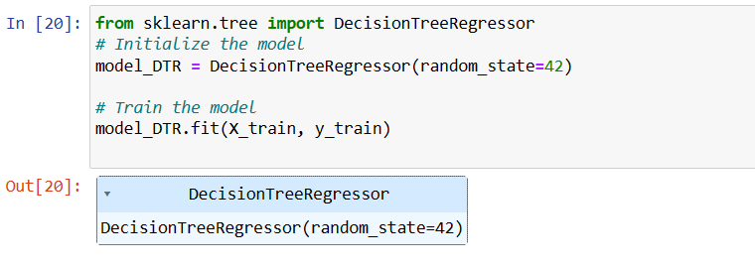
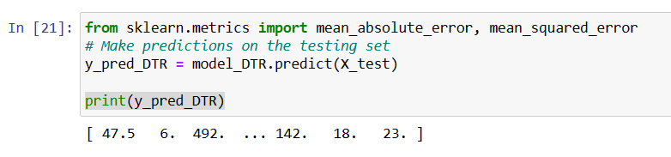
DecisionTreeRegressor
Predict the Test value and Looking

Slide 12
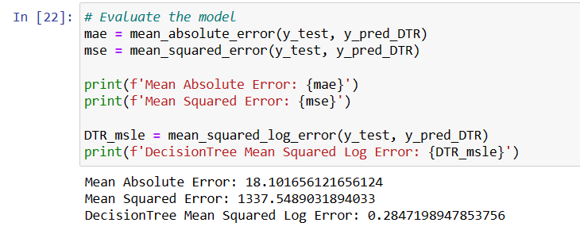
Checking Accuracy by finding Mean Sqaured Error
We found the,
MSE = 1337.549
MS log E = 0.2847

Slide 13
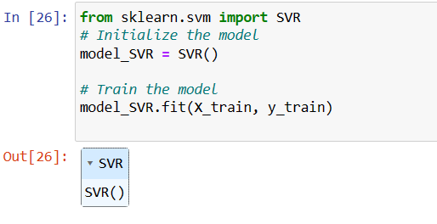
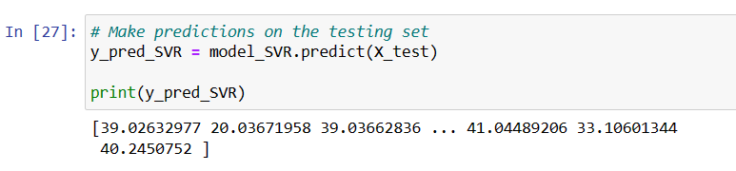
SVMRegression
Predict the Test value and Looking

Slide 14
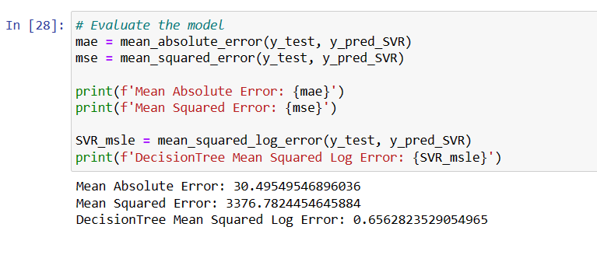
Checking Accuracy by finding Mean Sqaured Error
We found the,
MSE = 3376.78
MS log E = 0.6562

Slide 15
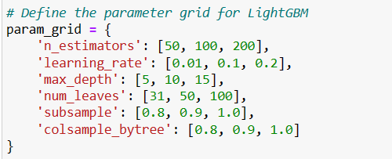
By comparing the MSEs of each models, choose one model to predict the unit sold for the next 12 weeks.
RF
MSE = 768.694
MS log E = 0.1844
LGBMR
MSE = 766.499
MS log E = 0.2745
DTR
MSE = 1337.549
MS log E = 0.0.2847
SVM
MSE = 3376.78
MS log E = 0.6562
We choose LightGBMRegression for the prediction according to it’s lowest MSE value.
Parameter Tuning

Slide 16
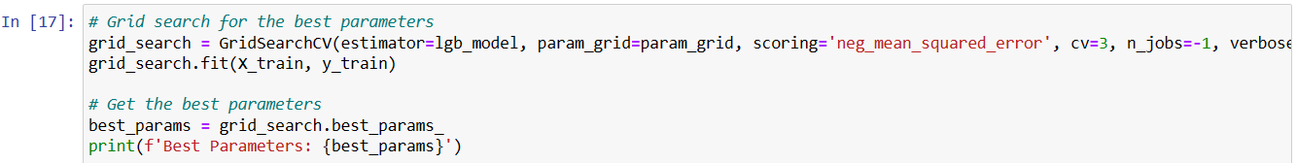
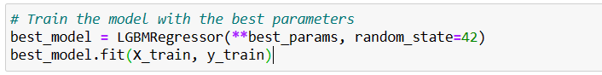
After Tuning

Slide 17
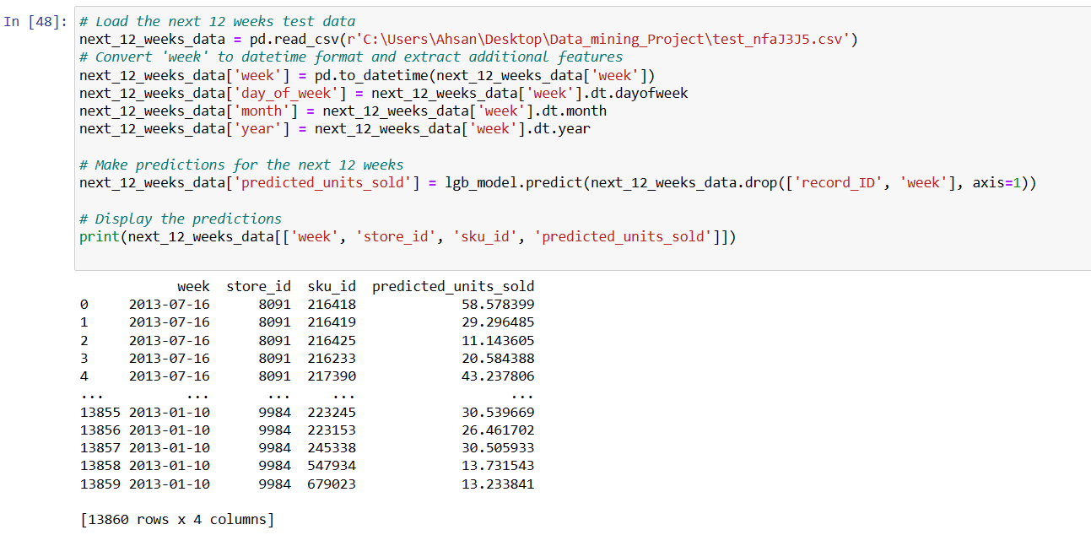
Prediction For The Next 12 Weeks

Slide 18
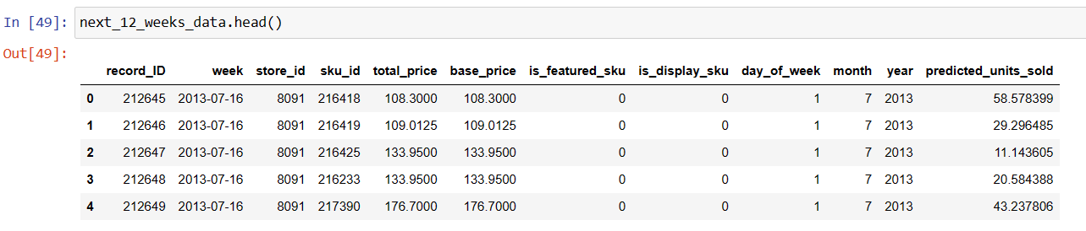
View Some of Next 12 Weeks Data

Slide 19
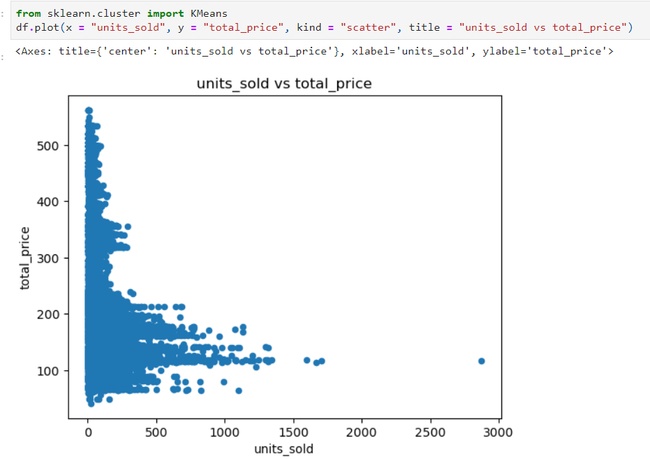
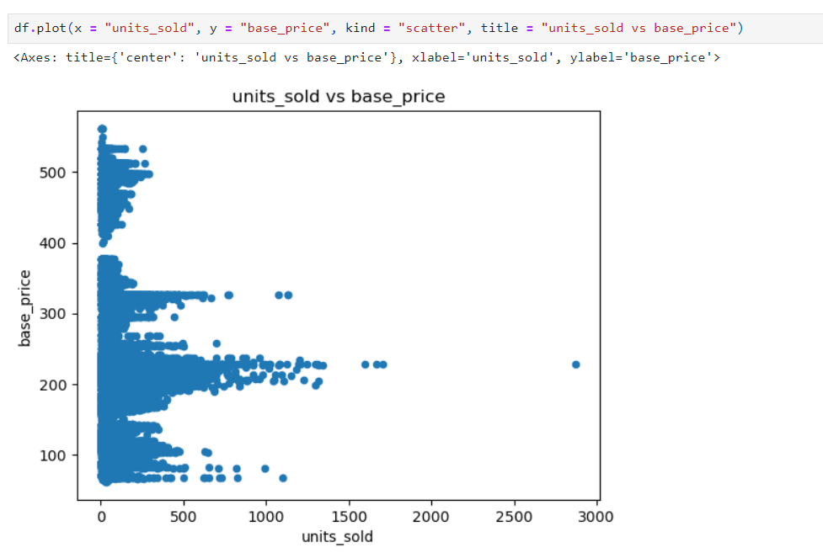
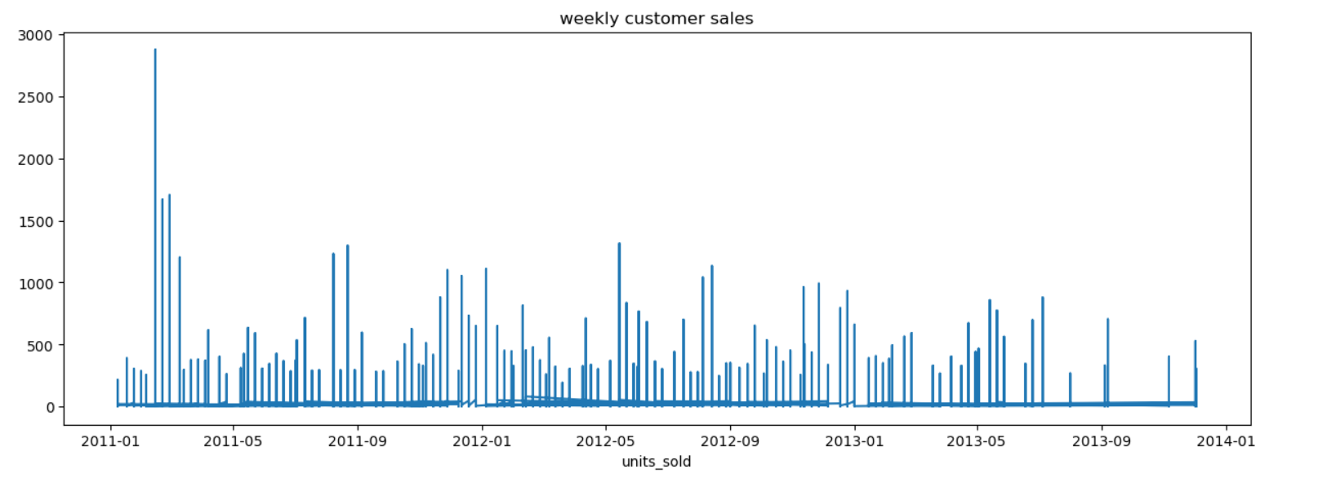
Scatter Plot of 'units_sold' vs 'total_price'
VISUALIZATION
Scatter Plot of 'units_sold' vs ‘base_price'
Time Series Plot: Weekly Units Sold

Slide 20
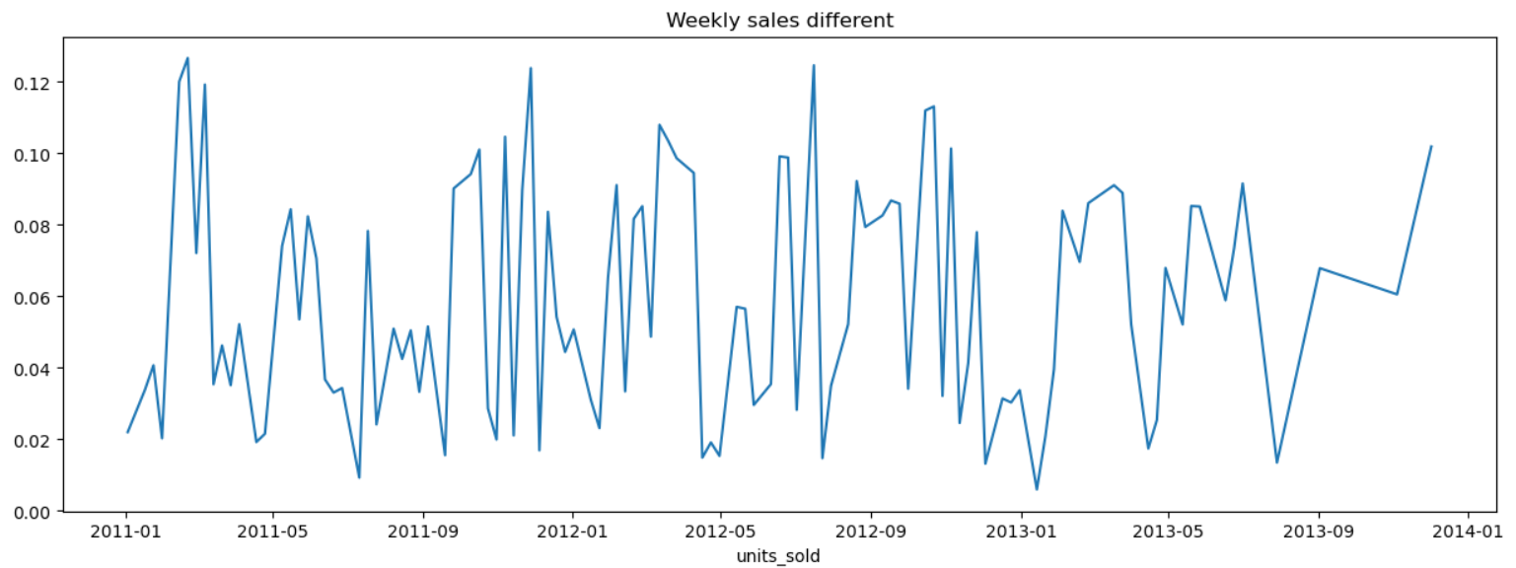
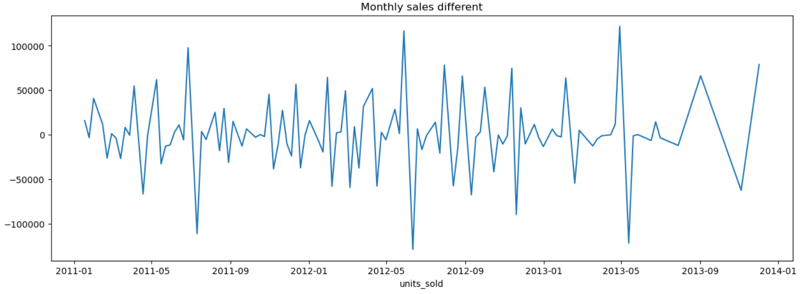
Time Series Plot: Weekly Sales Differences
Time Series Plot: Monthly Sales Differences

Slide 21
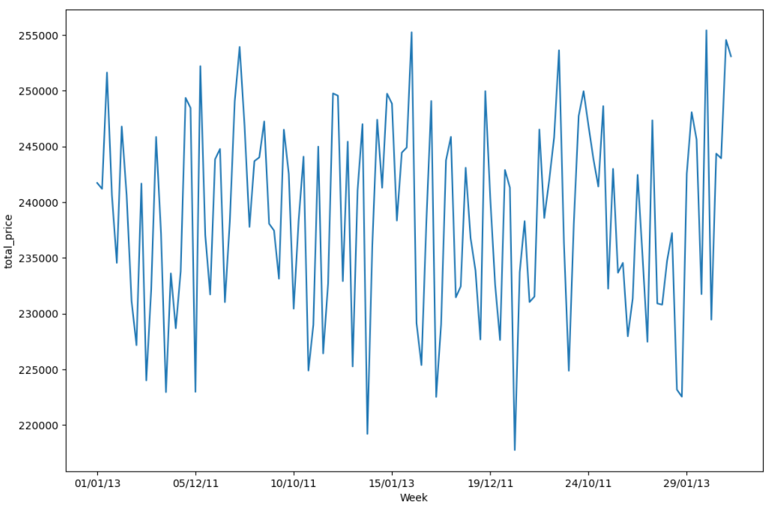
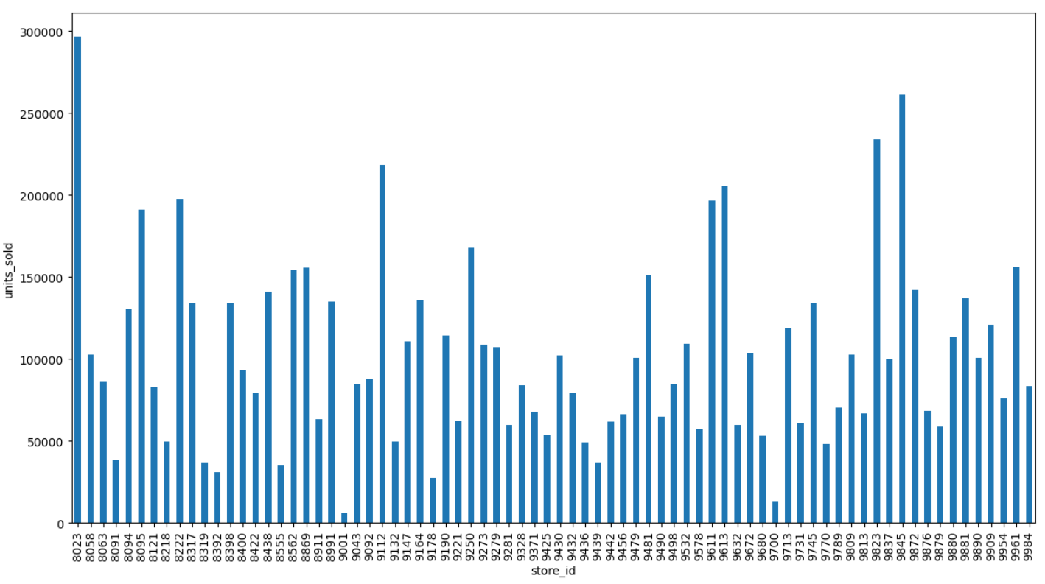
Weekly Total Sales Revenue
Total Units Sold by Store

Slide 22
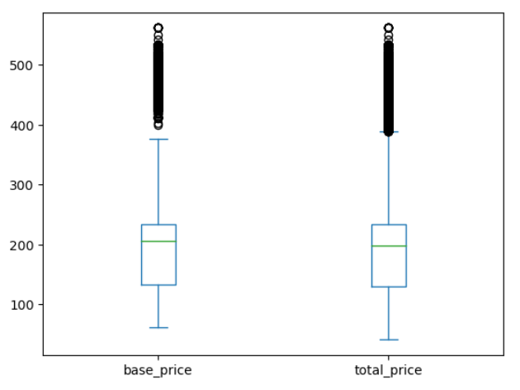
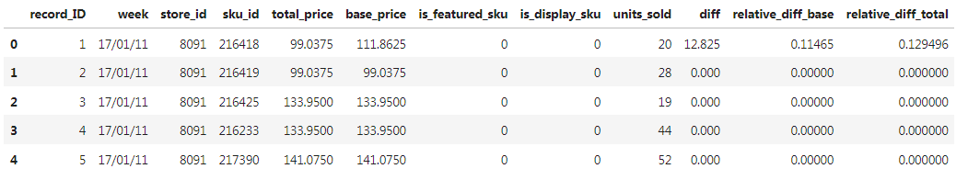
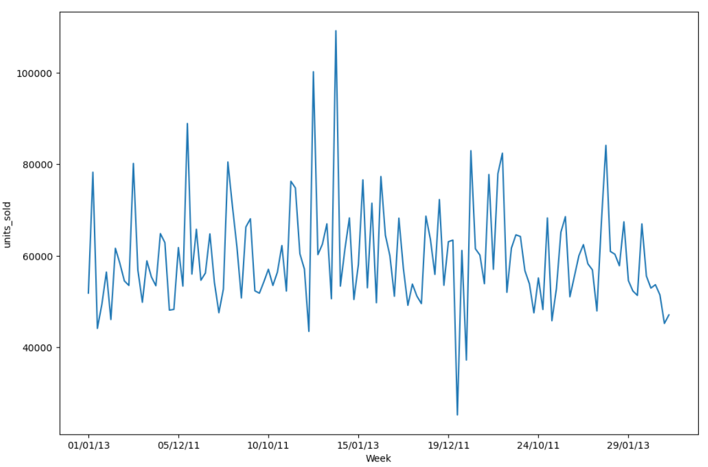
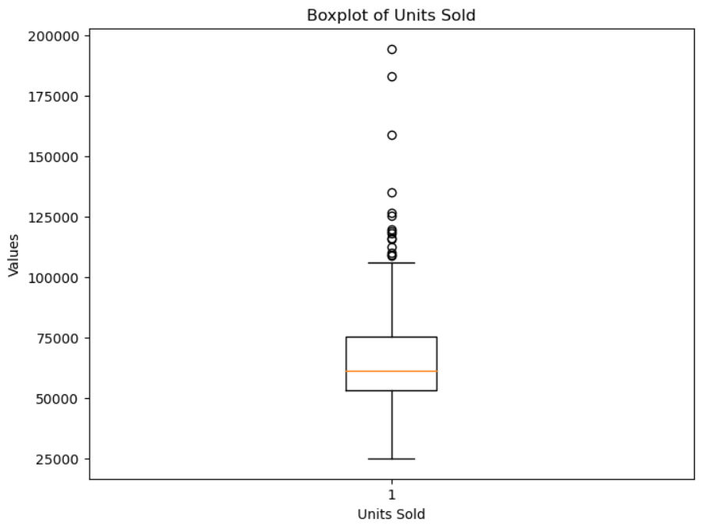
Box Plot: Base Price and Total Price
Created new features in your training dataset
Diff, relative_diff_base, andrelative_diff_total
Weekly Units Sold Trend
Box Plot: Units Sold Distribution

Slide 23
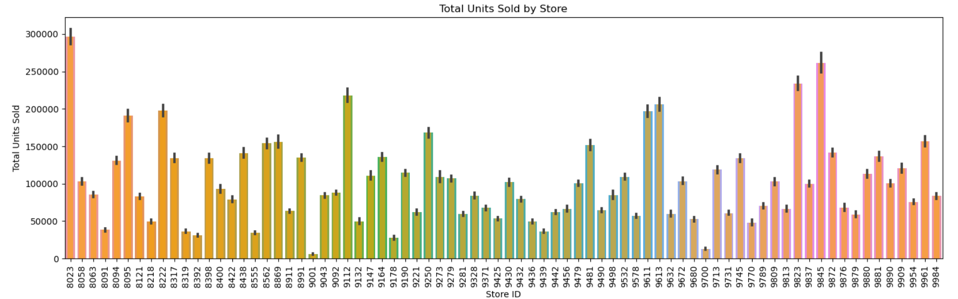
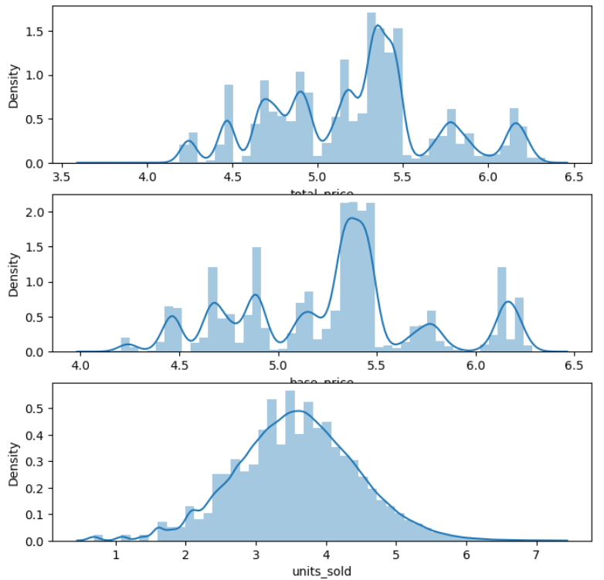
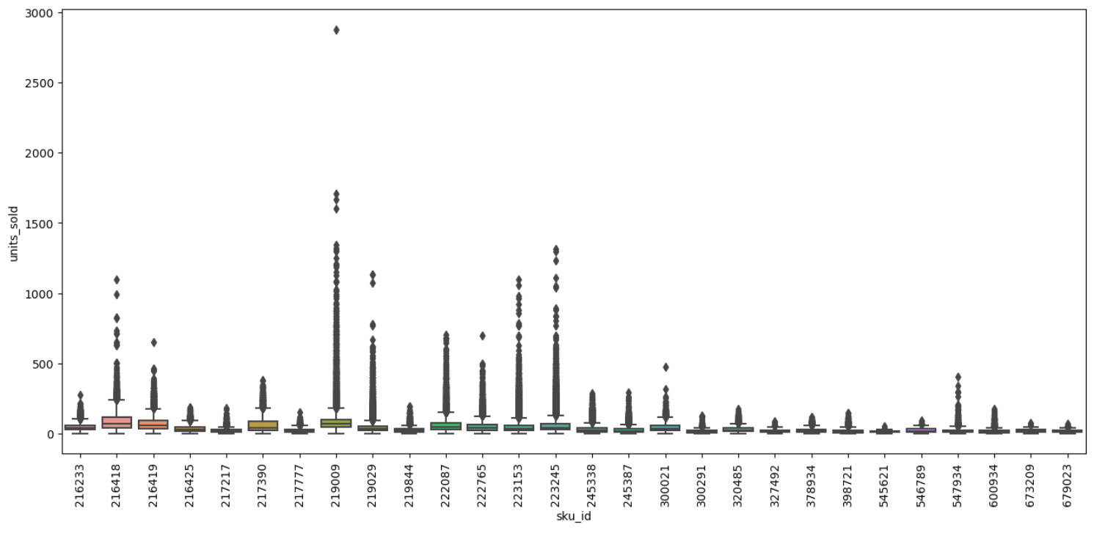
Total Units Sold by Store
Distributions of Numerical Variables
Total Price
Base Price
Units Sold
Boxplot of Units Sold by SKU

Slide 24
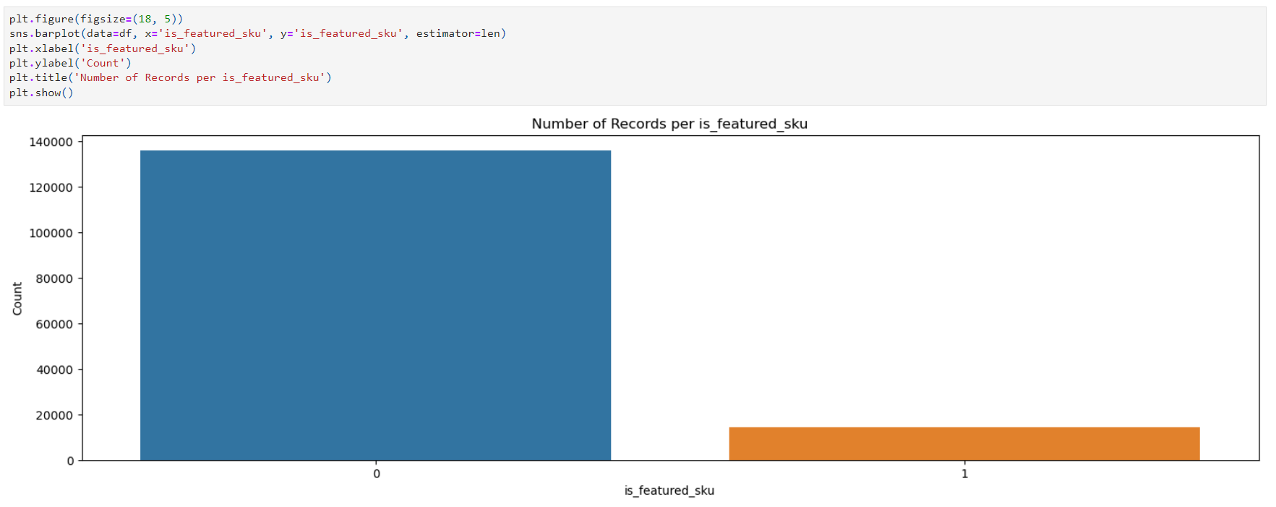
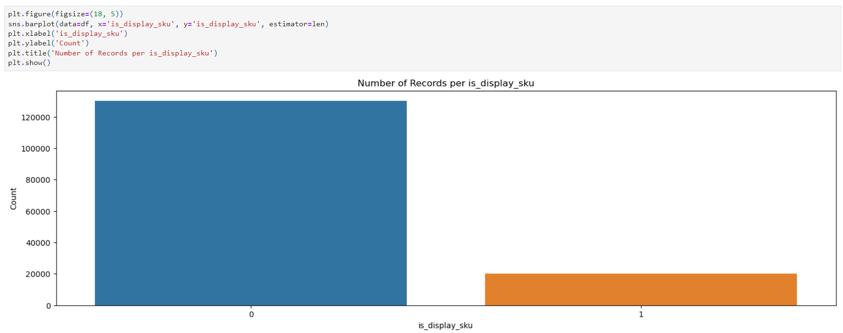
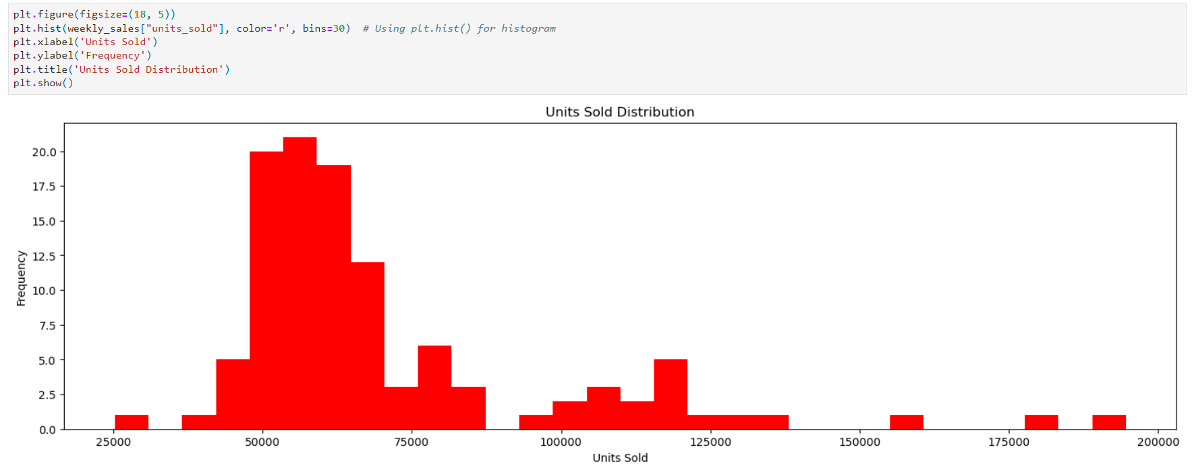
Count of Records by is_featured_sku
Count of Records by is_display_sku
Histogram: Units Sold Distribution

Slide 25
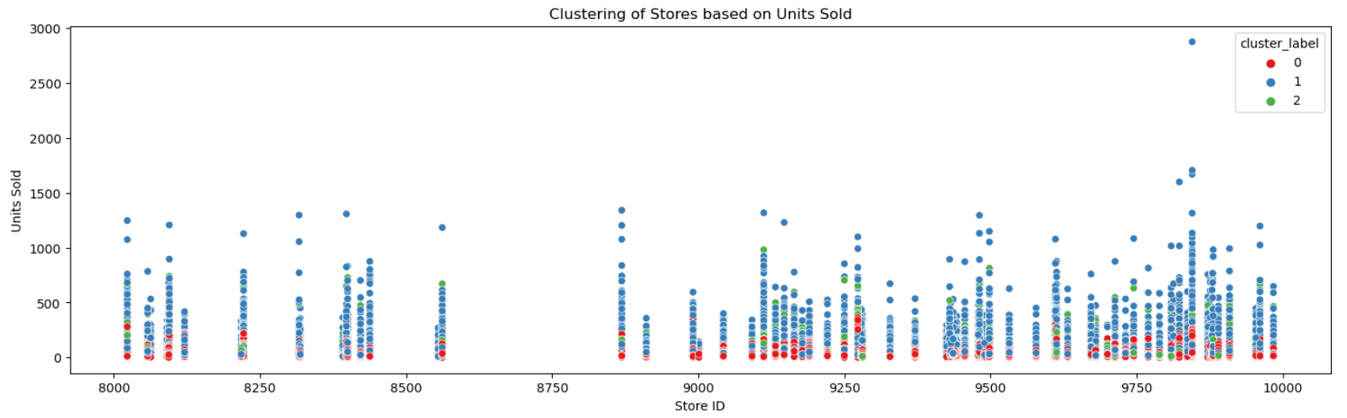
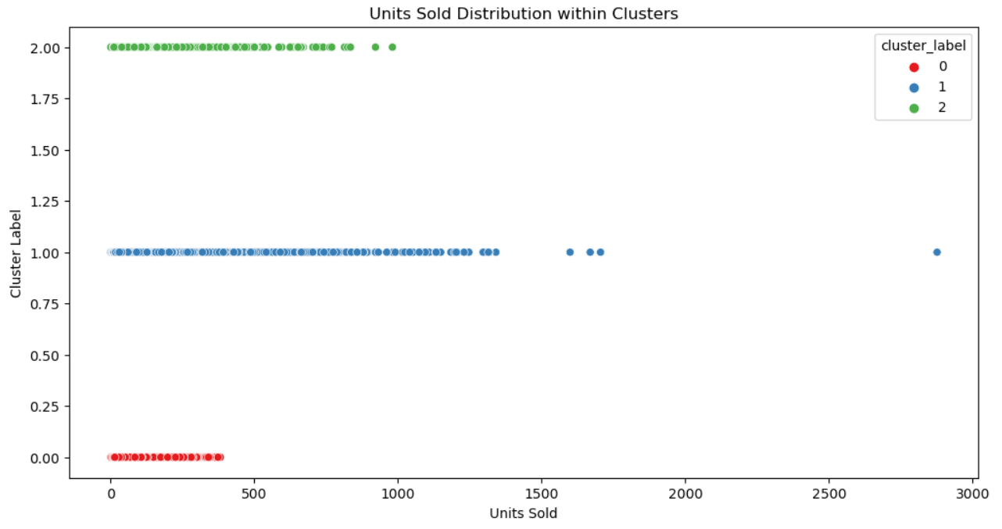
CLUSTERING
Store Clustering Based on Units Sold
Units Sold Distribution within Clusters

Slide 26
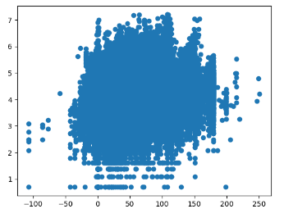
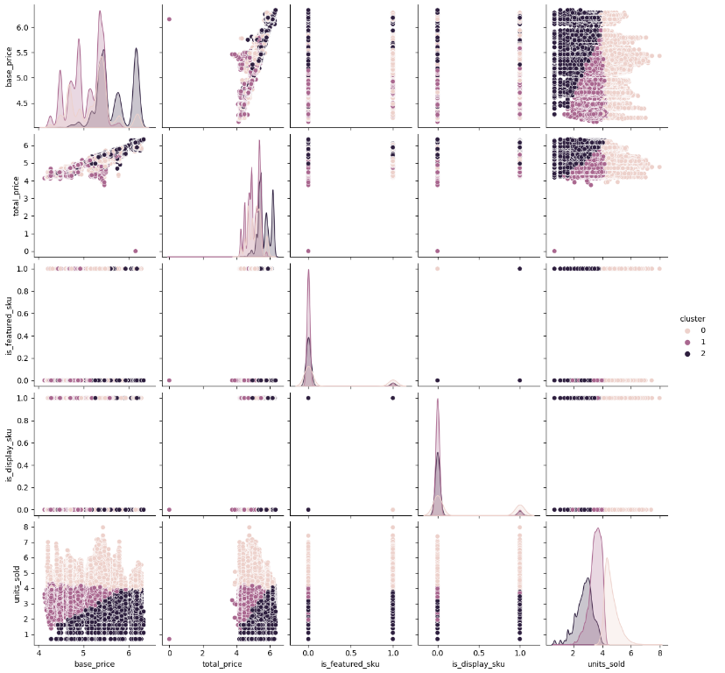
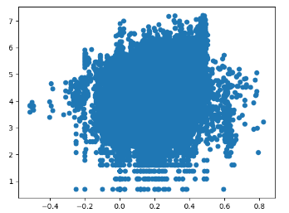
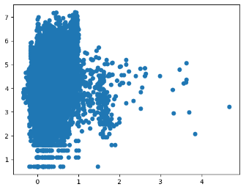
Pair Plot of Clusters Based on Product Features
Scatter Plot: Price Difference vs Units Sold
Scatter Plot: Relative Difference (Base Price) vs Units Sold
Scatter Plot: Relative Difference (Total Price) vs Units Sold

Slide 27
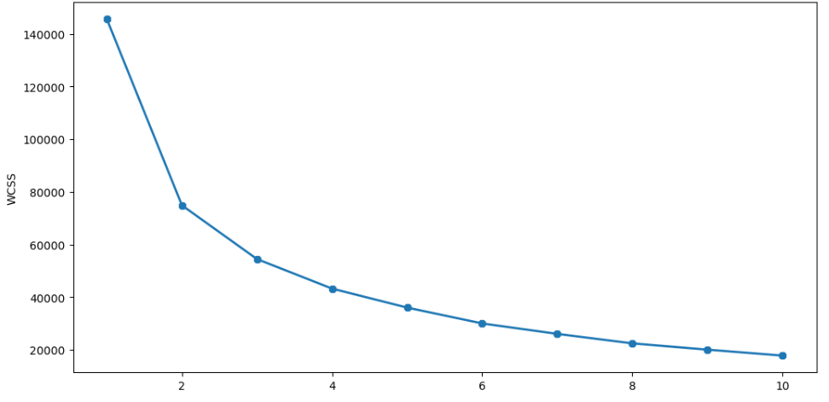
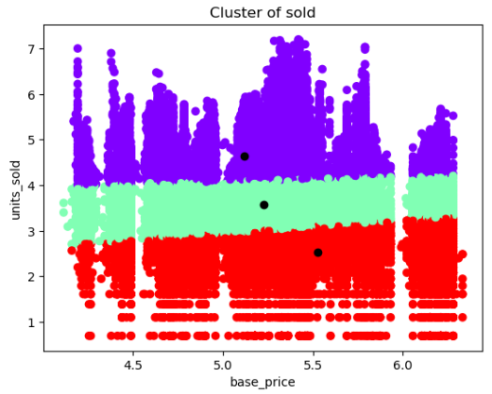
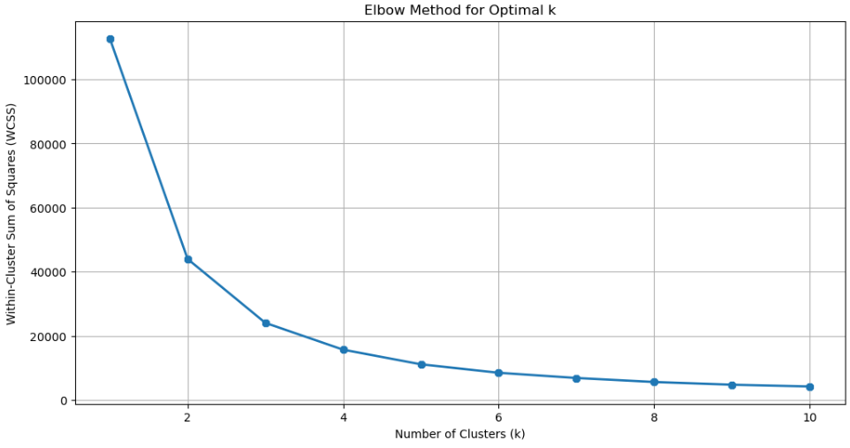
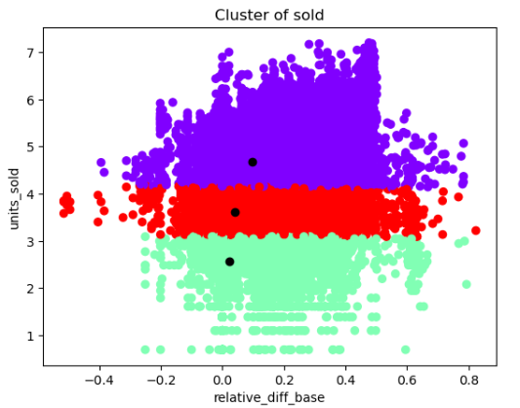
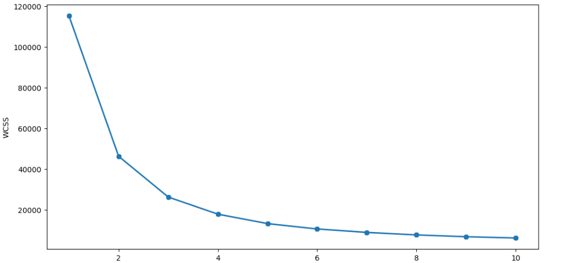

Elbow Method: Base Price vs Units Sold
KMeans Clustering: Base Price vs Units Sold
KMeans Clustering: Relative Difference (Base Price) vs Units Sold
Elbow Method: Relative Difference (Base Price) vs Units Sold
KMeans Clustering: Relative Difference (Total Price) vs Units Sold
Elbow Method: Relative Difference (Total Price) vs Units Sold

Slide 28

Heatmap: Correlation Matrix

Slide 29




Scatter Plot: Store ID vs Units Sold
Scatter Plot: SKU ID vs Units Sold
Scatter Plot: Featured SKU vs Units Sold
Scatter Plot: Displayed SKU vs Units Sold

Slide 30


Elbow Method : SKU ID vs Units Sold
K-Means Clustering: SKU ID vs Units Sold

Slide 31


2D Principal Component Analysis (PCA) Visualization
3D Principal Component Analysis (PCA) Visualization

Slide 32
THANK YOU

